Slide 1

Spaces for Wellbeing

Slide 2

Housekeeping

Slide 3

We will be using JAMBOARDS to post feedback from the discussions.

Slide 4
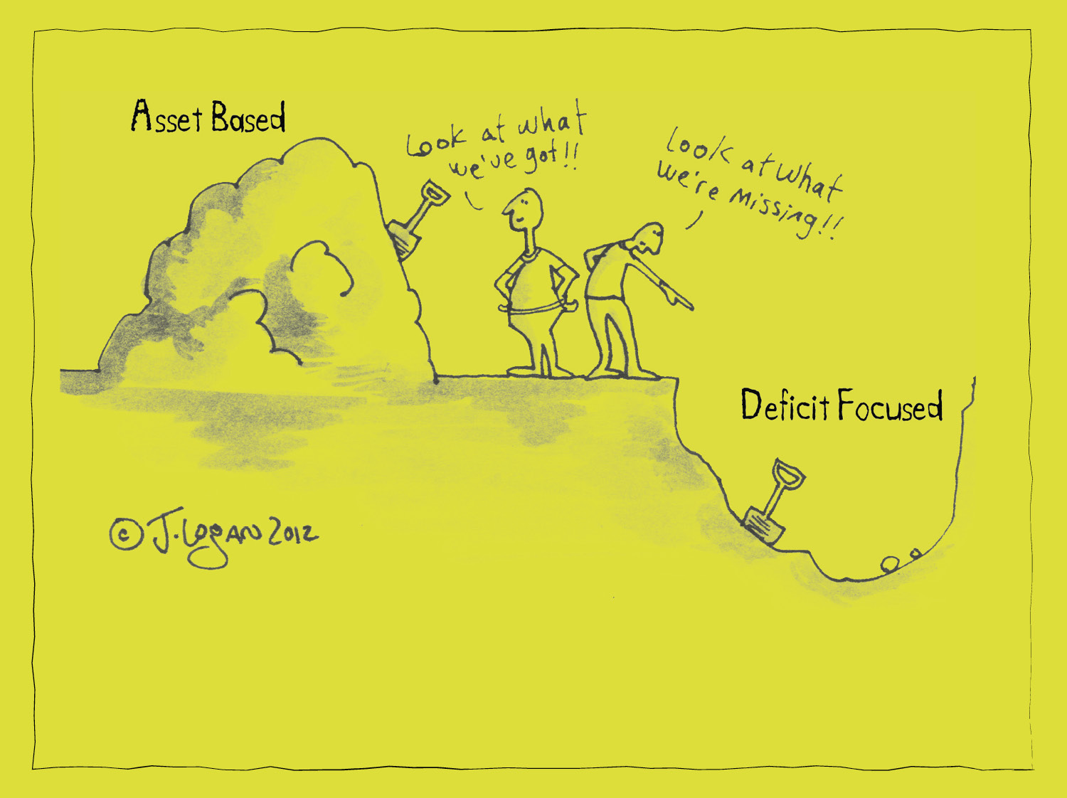
Appreciative Enquiry

Slide 5
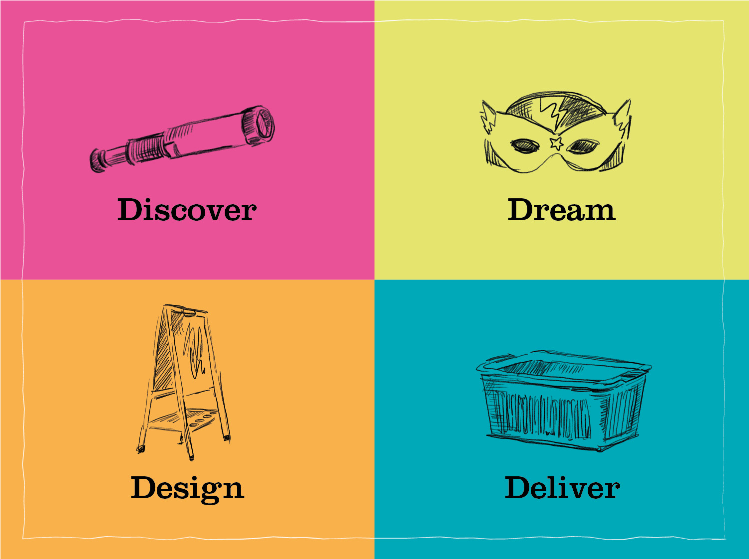

Slide 6

What do we know?

Slide 7
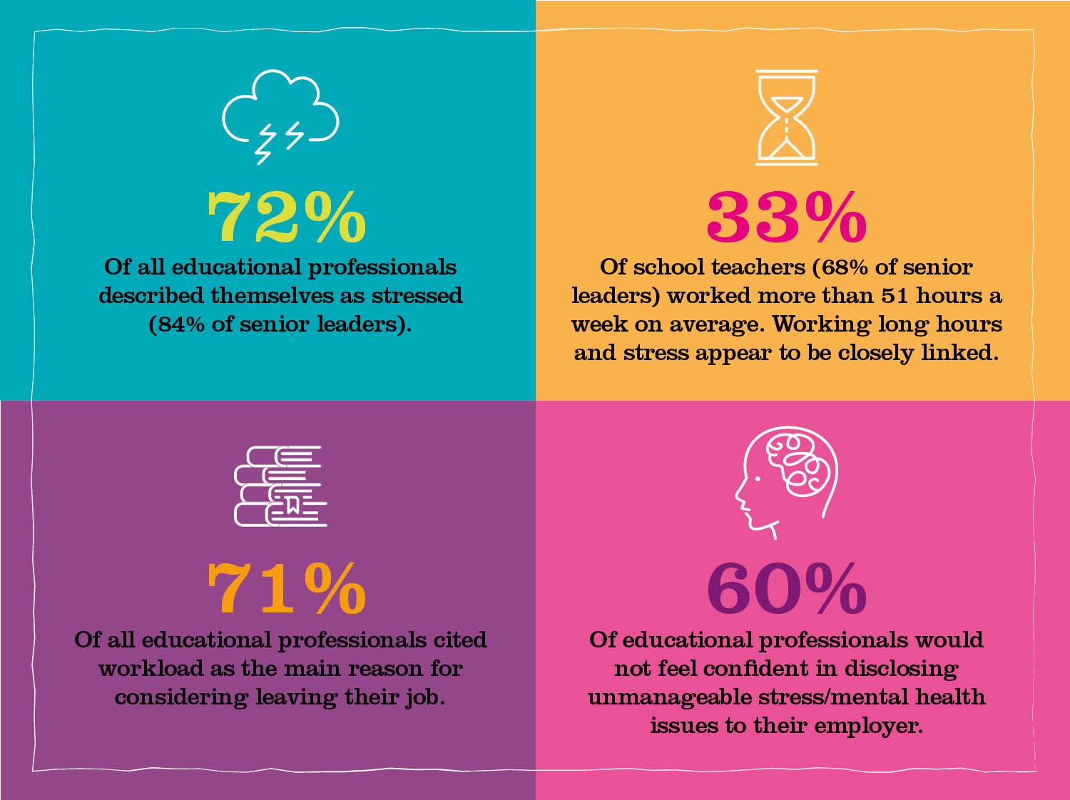

Slide 8

Quick and a little bit muddy

Slide 9

Discover

Slide 10

When your wellbeing was
at its best it was like what?
I was…

Slide 11

When your TEAM’S wellbeing was
at its best it was like what?
We were…

Slide 12
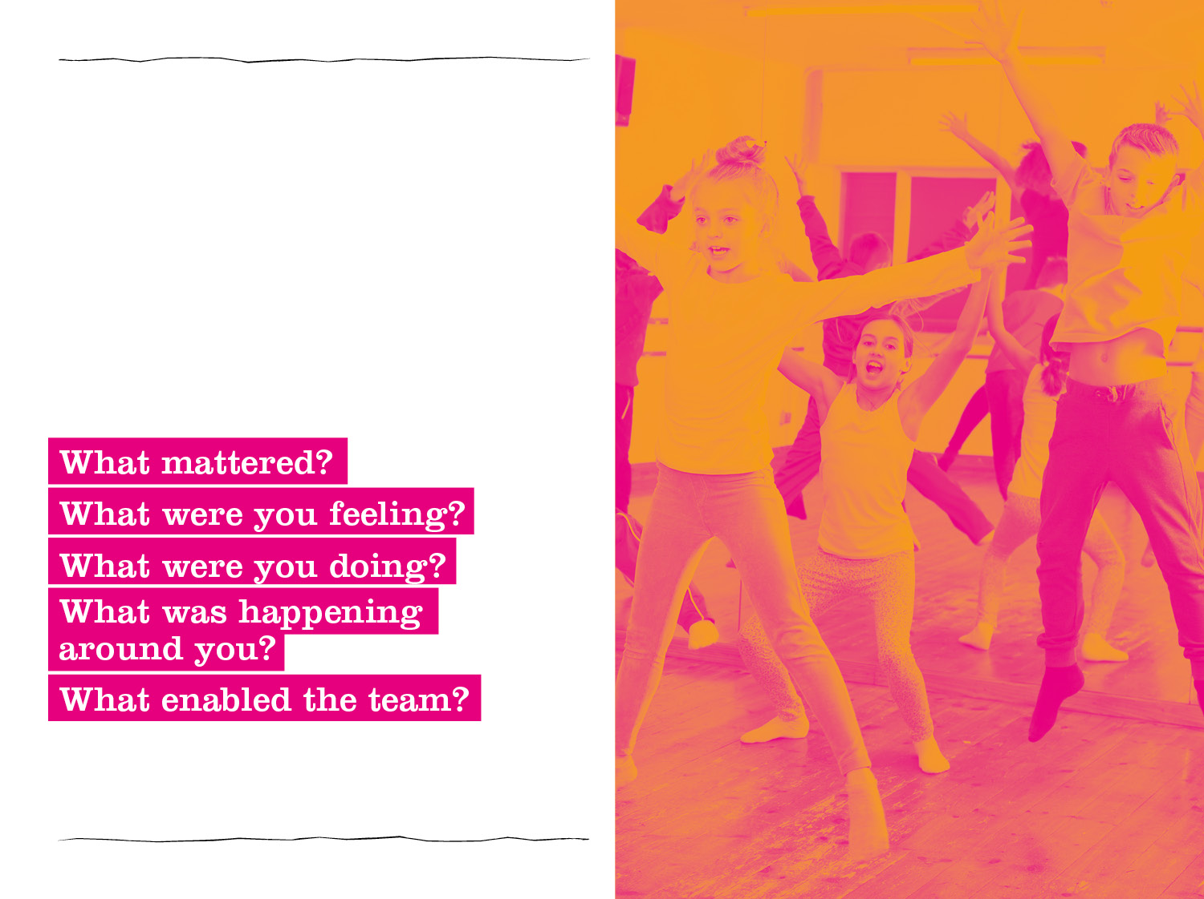
When your Organisation’s
wellbeing was
at its best it was like what?
They was…

Slide 13

Back to the JAMBOARDS...

Slide 14
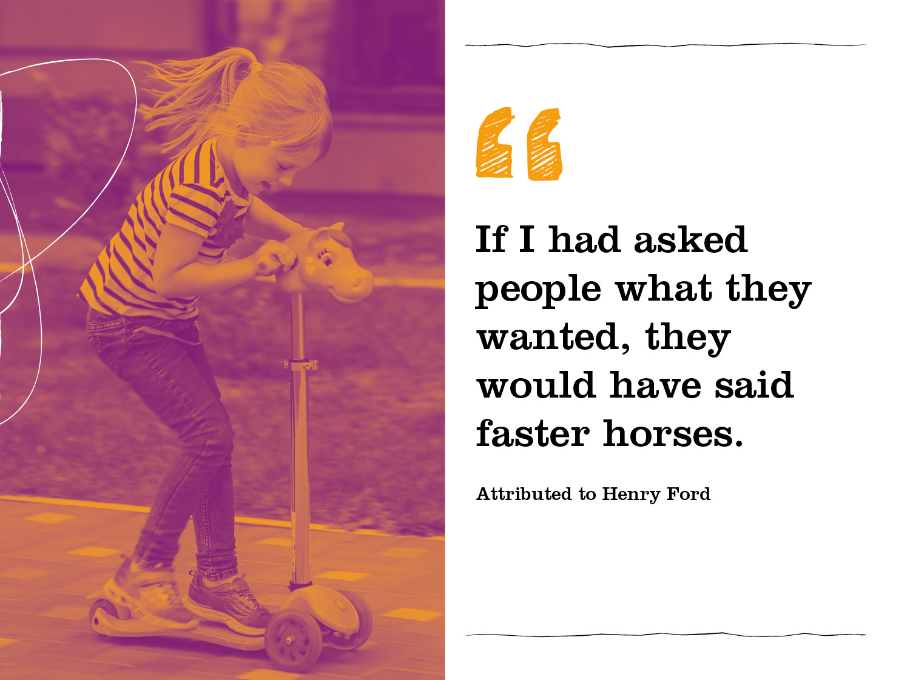

Slide 15
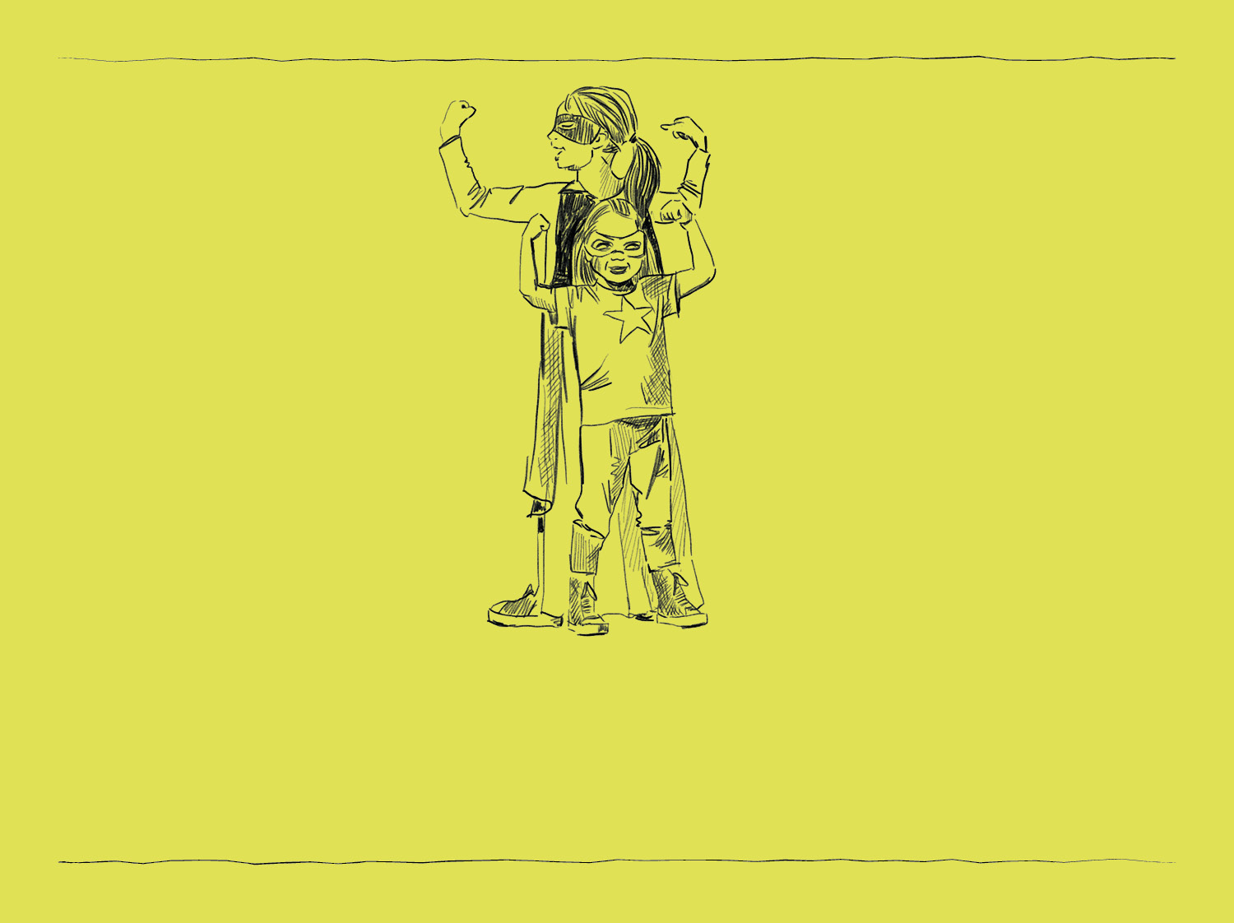
Dream
What would you like to have happen?

Slide 16
Back to the JAMBOARDS...

Slide 17

Spaces for Wellbeing
Part 2 Supporting Education Staff

Slide 18
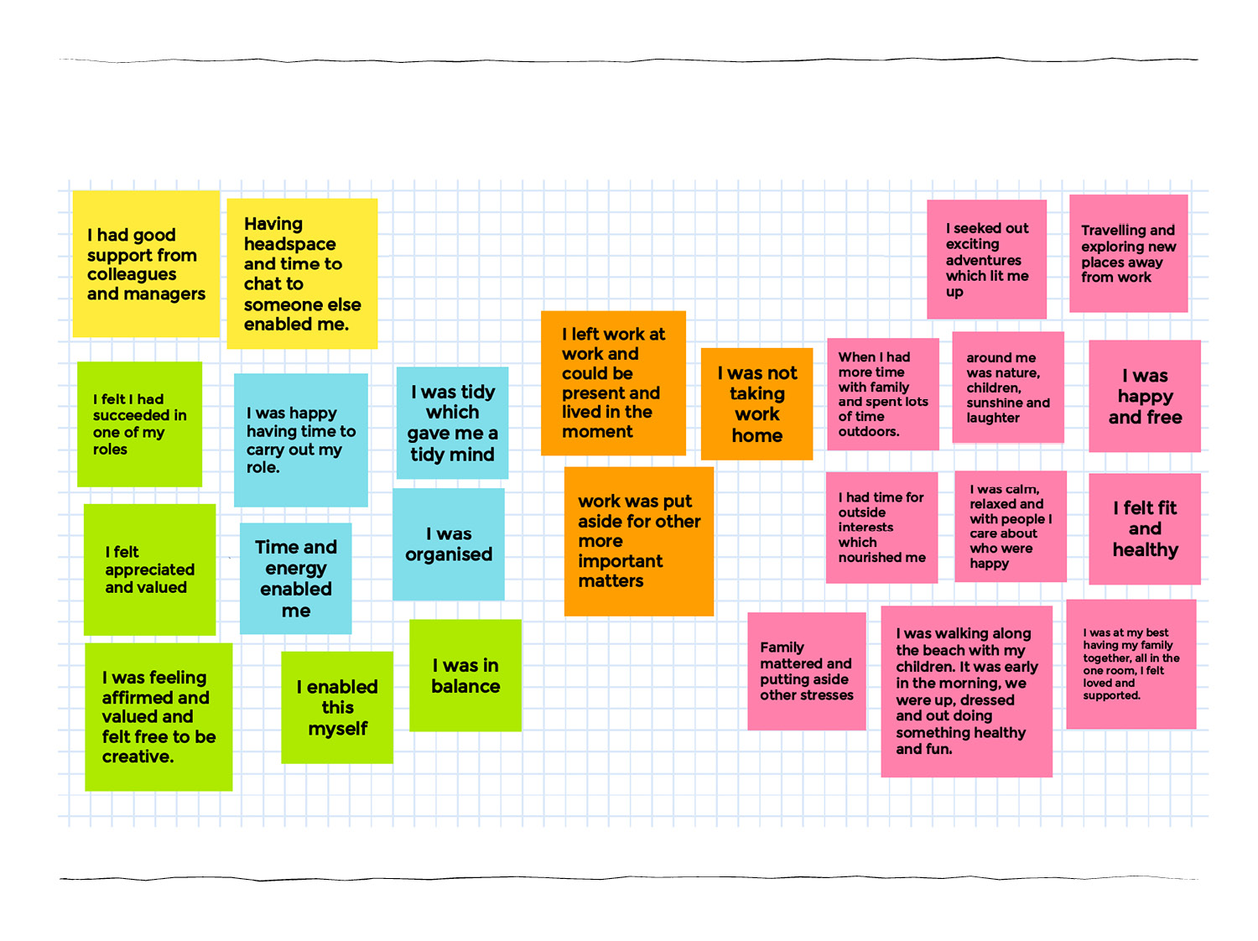
Tidy up the Jamboard

Slide 19
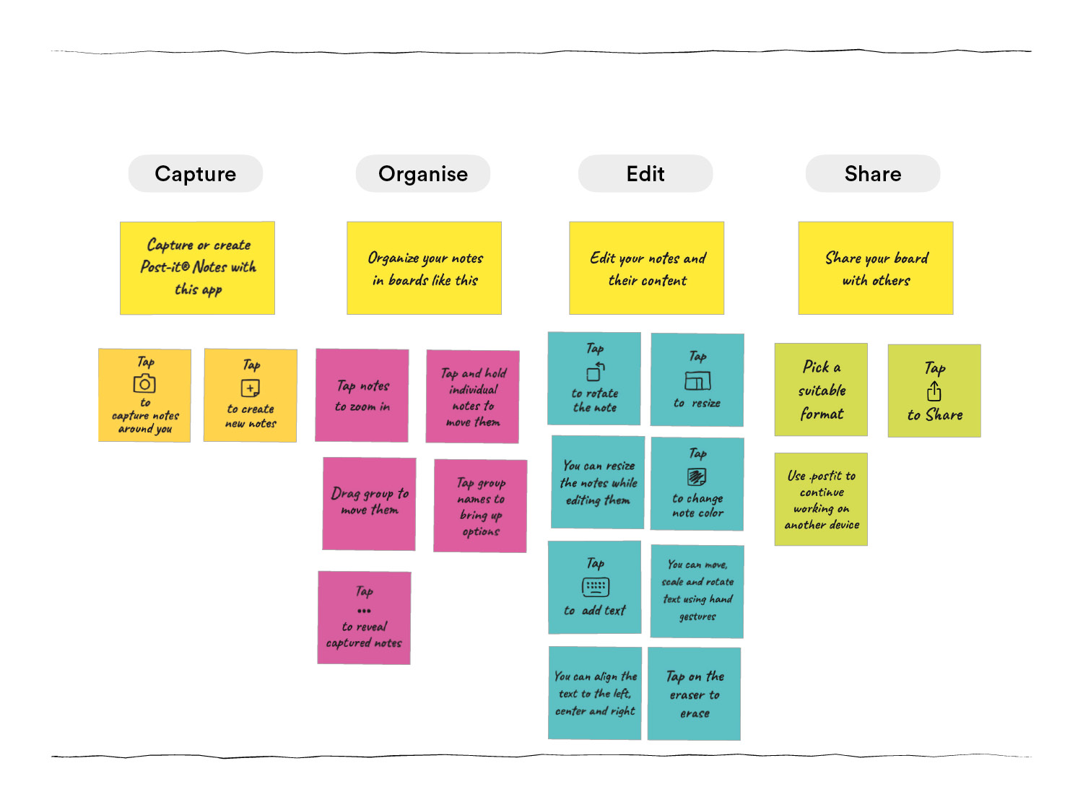
Post it app helps sort it out

Slide 20
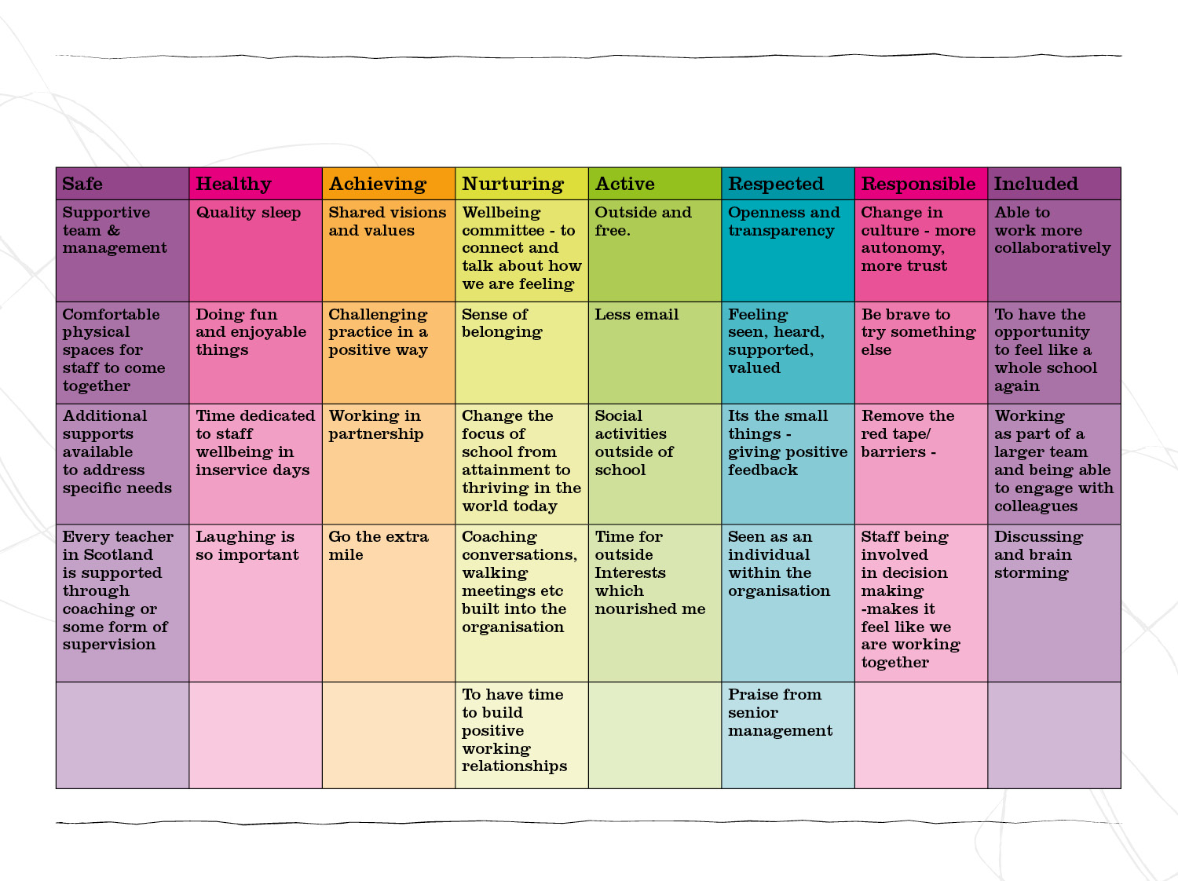
Mapping your dreams to the Wellbeing Grid

Slide 21
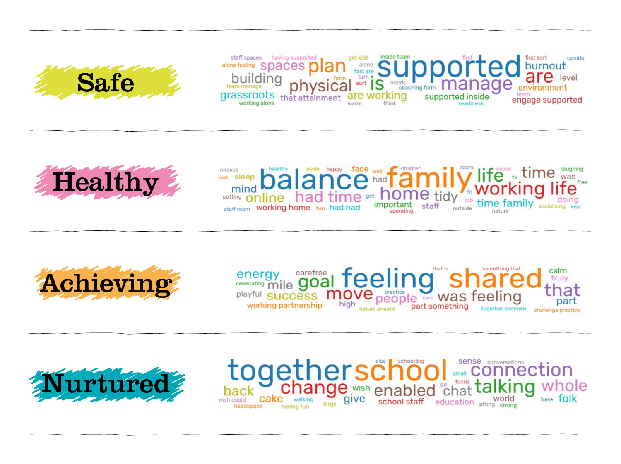

Slide 22
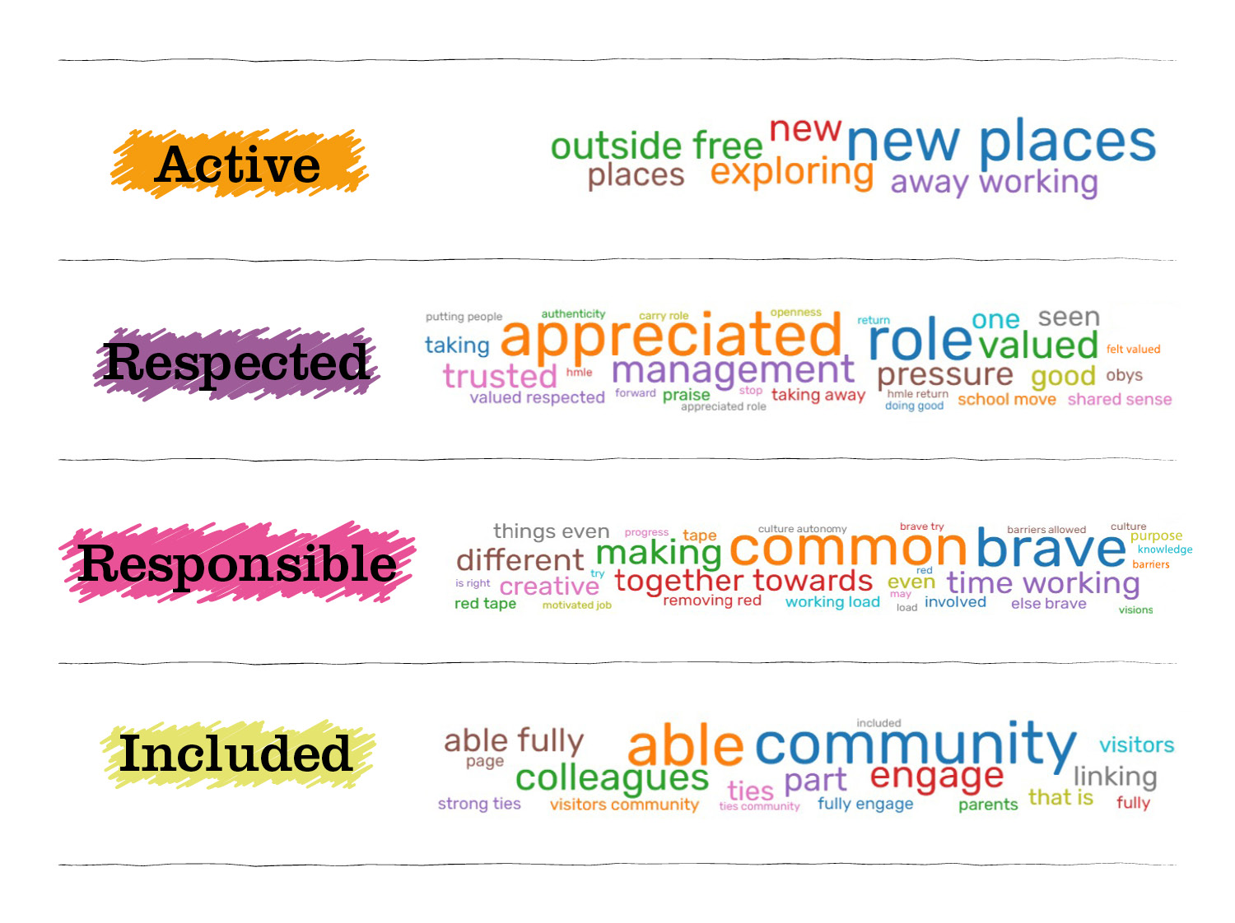

Slide 23
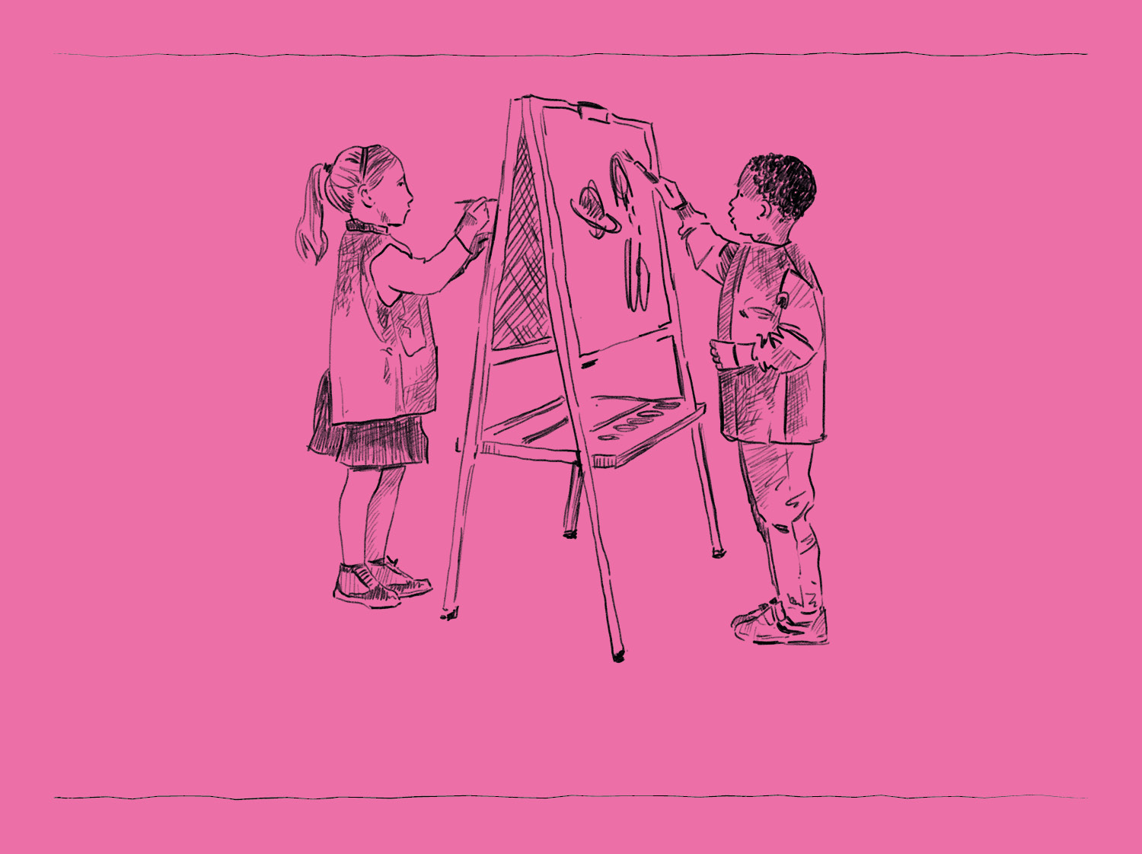
Design

Slide 24
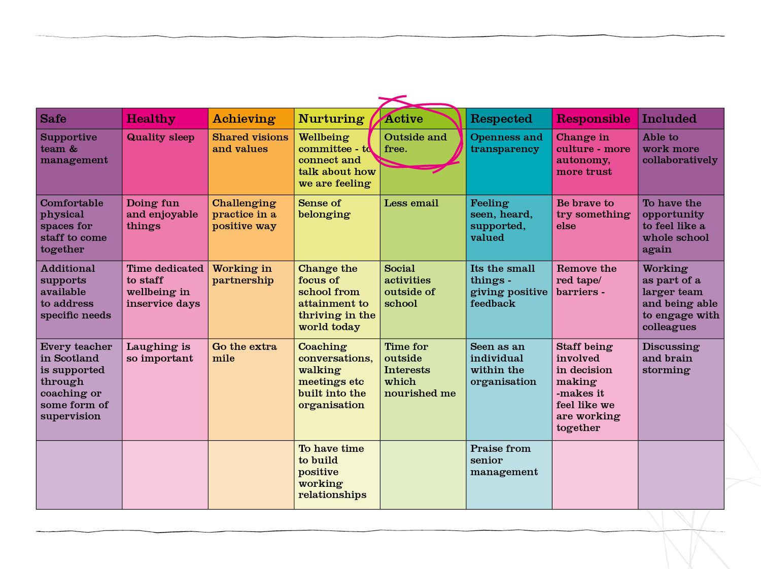
Outside and free

Slide 25
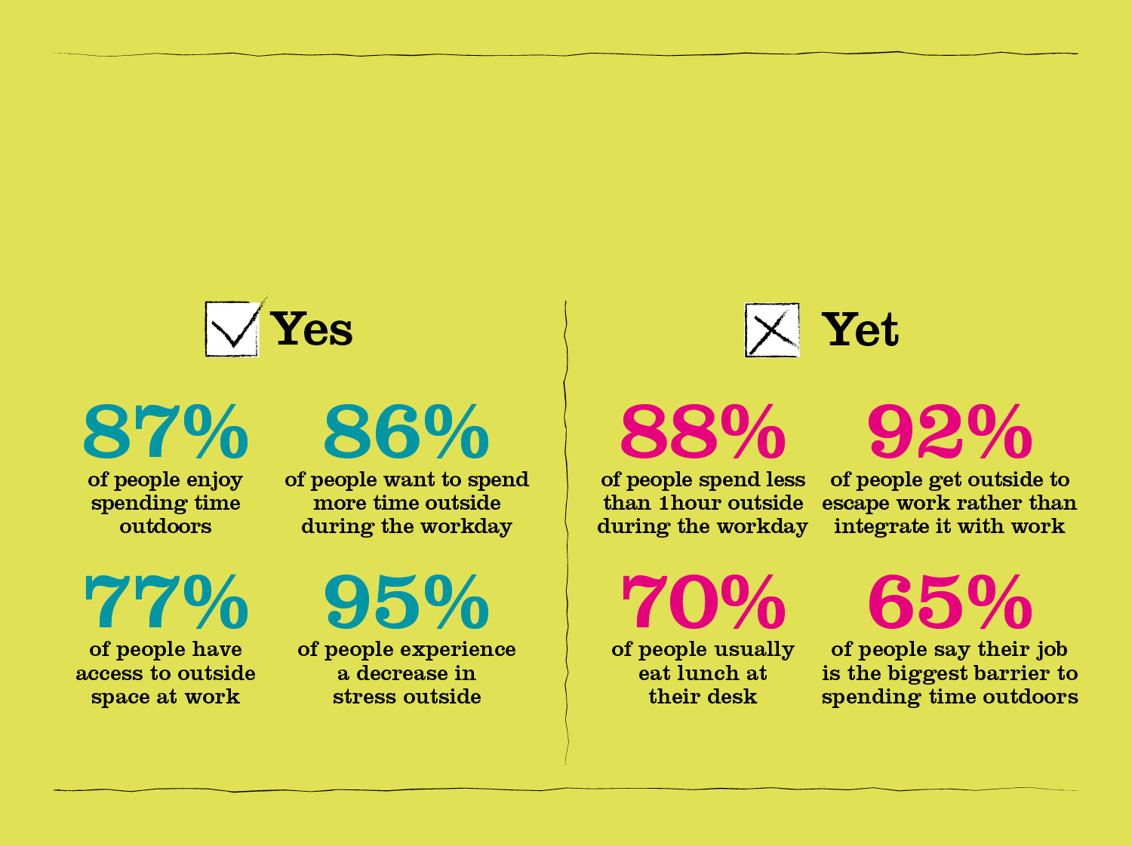
Bring the outside into the workplace
Research shows you don’t have to go far or spend long outside to get the benefits. Just getting outside and walking for 5 minutes at a time improves both mood and self esteem.

Slide 26

Dream

Slide 27
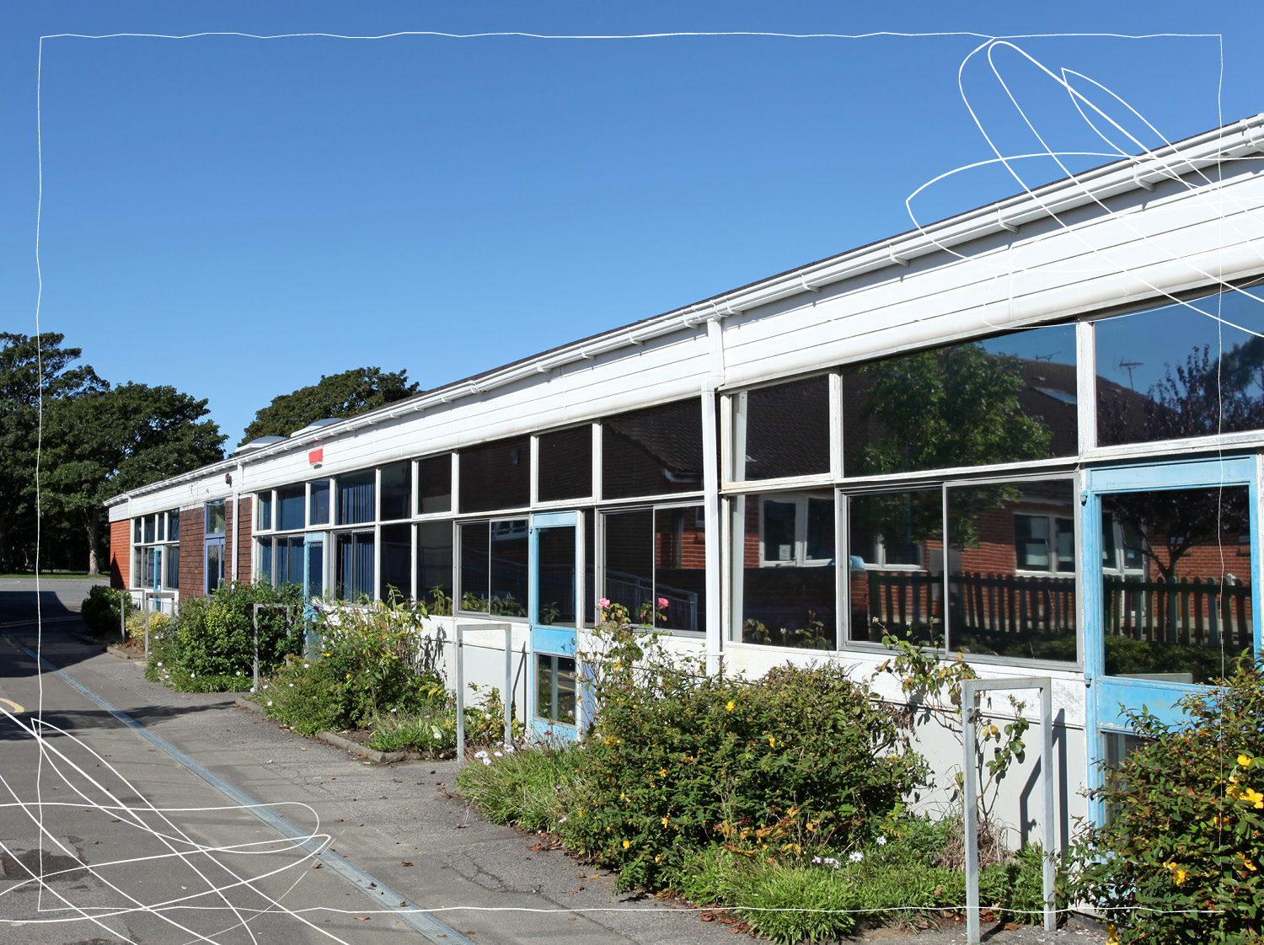
Reality

Slide 28
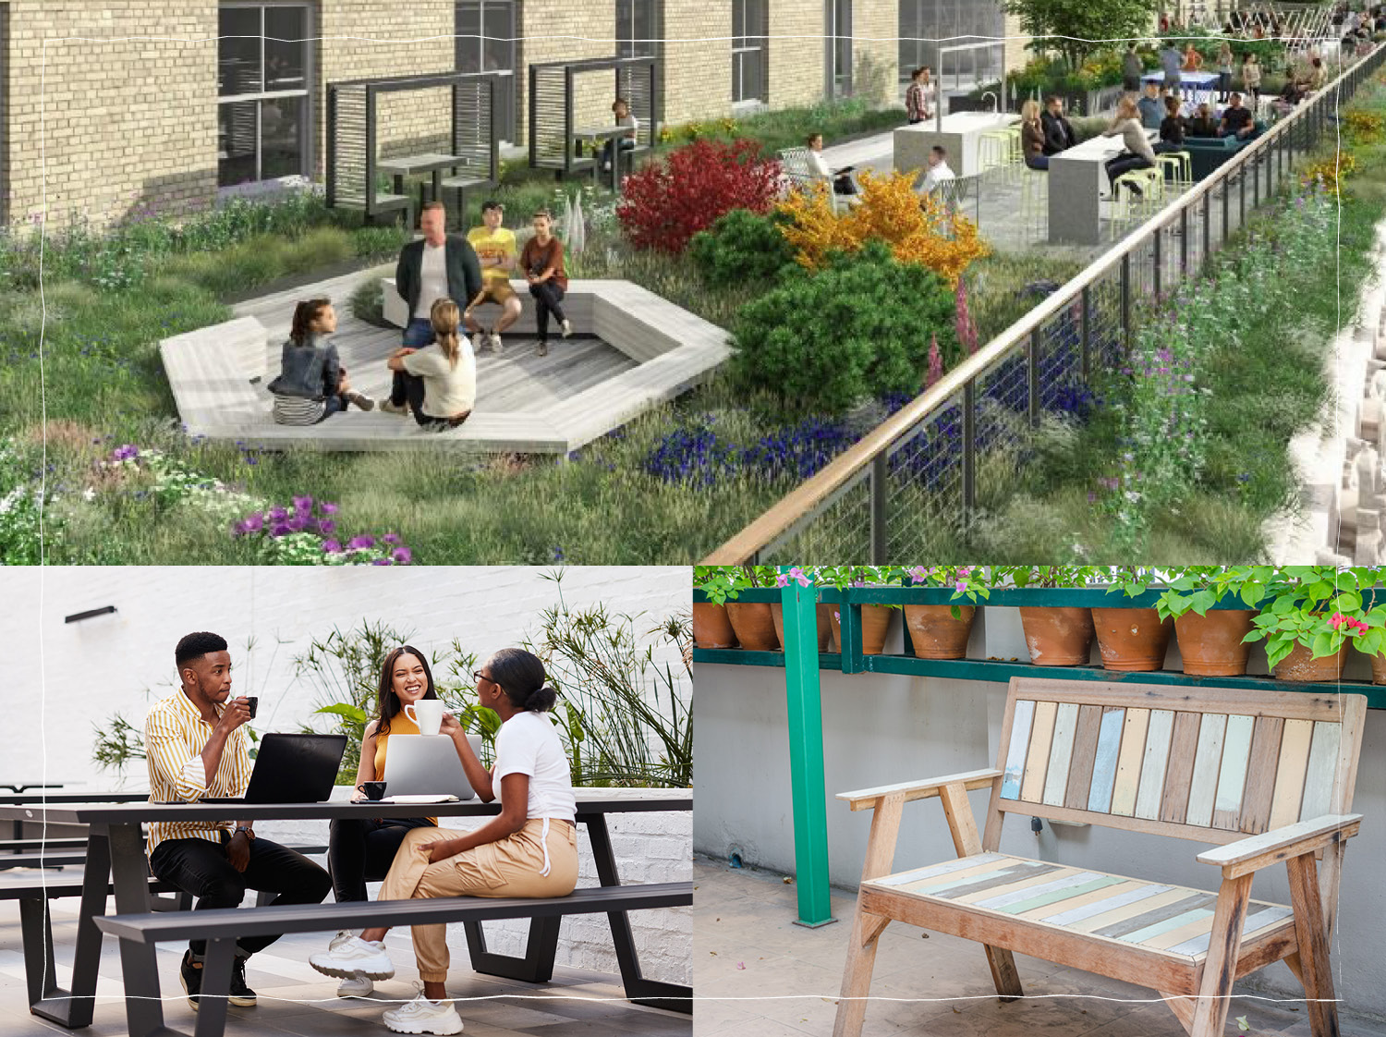
Better is possible

Slide 29
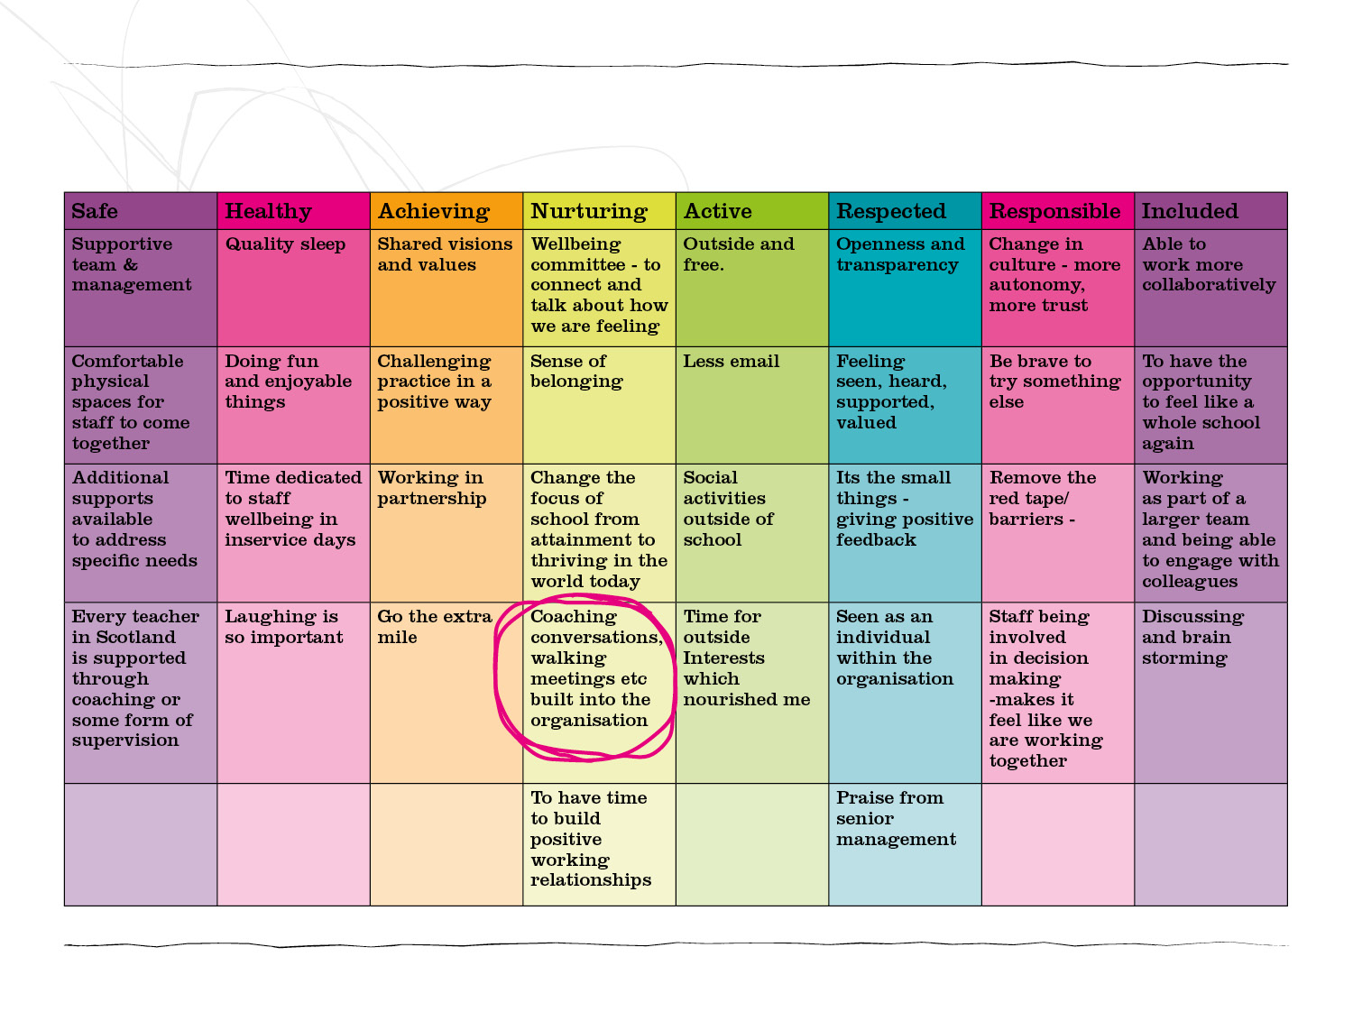
Walking meetings

Slide 30
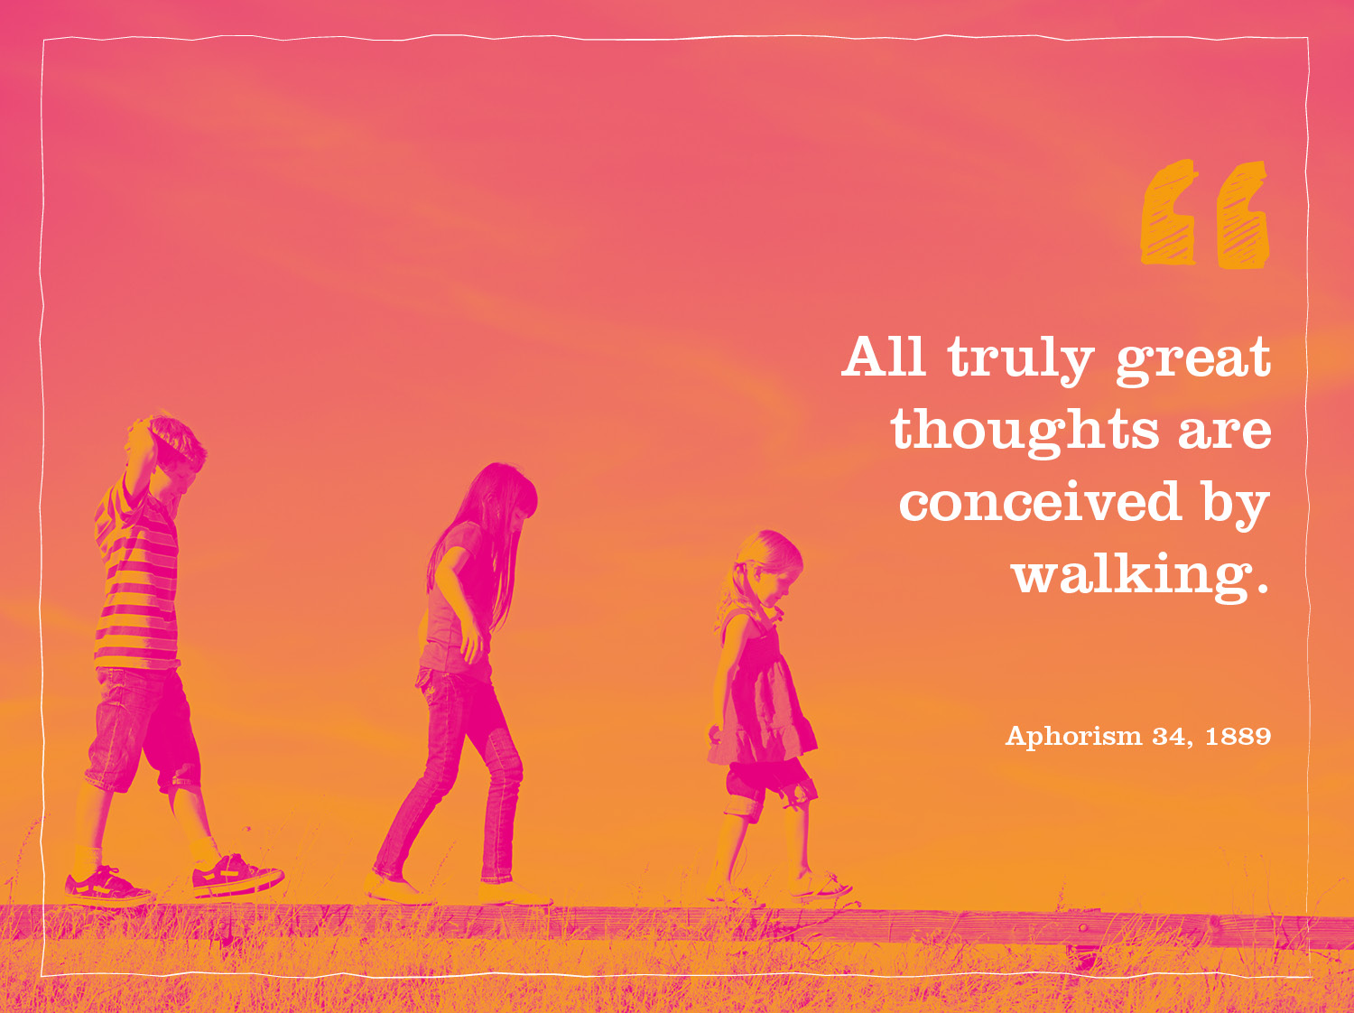

Slide 31

Routes for walking meetings
around the school

Slide 32
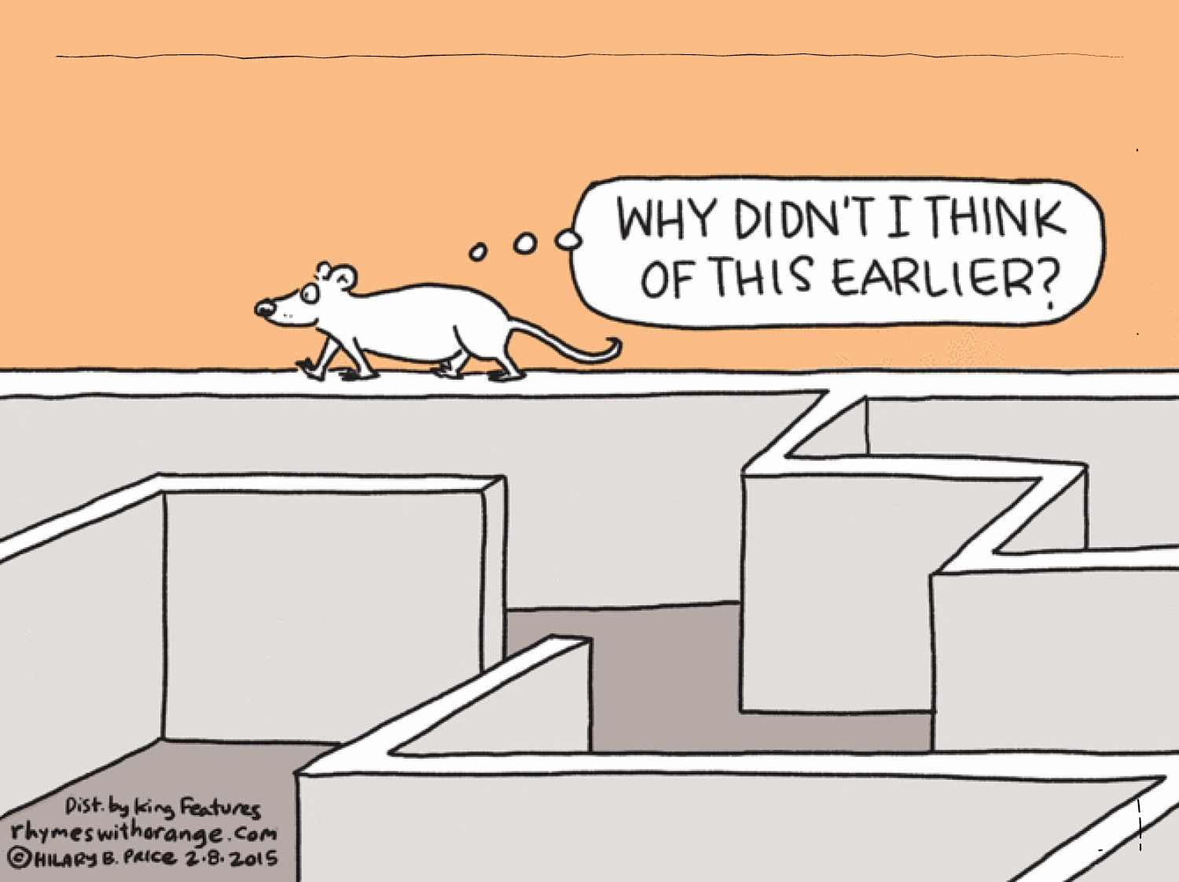

Slide 33

Now its your turn – add your own grid

Slide 34

Deliver

Slide 35
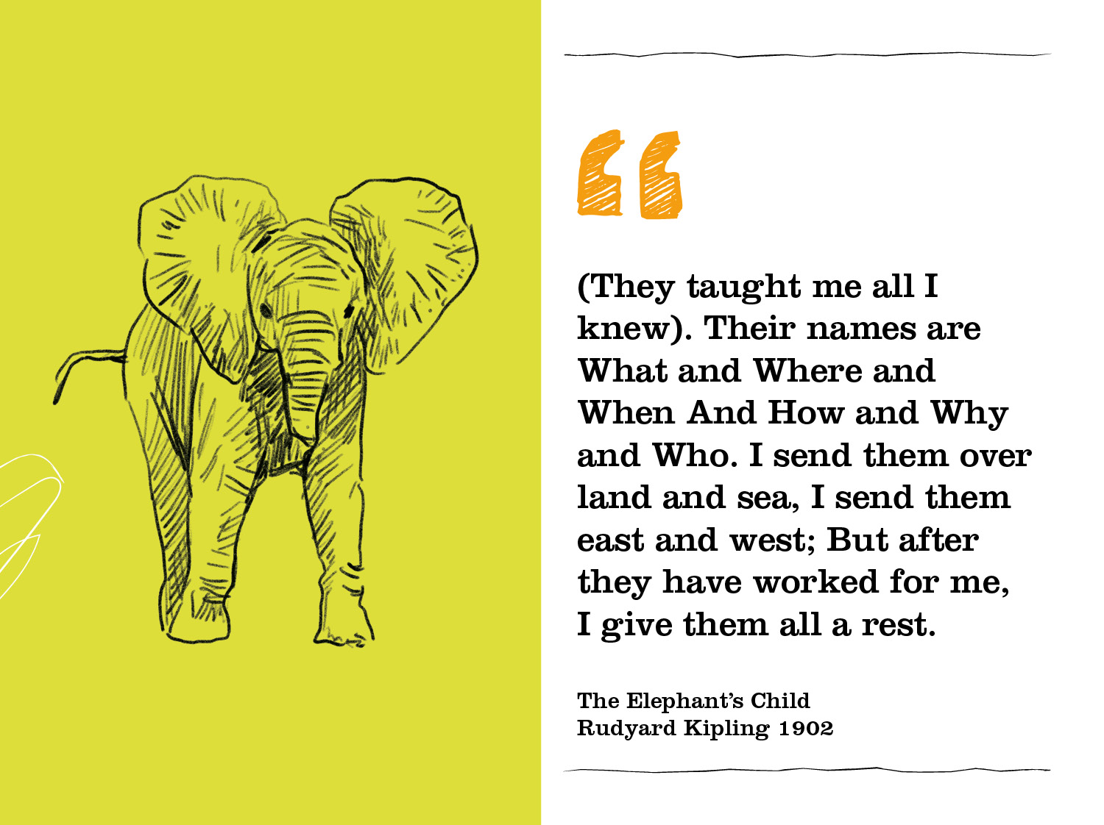

Slide 36

When? Where? What? Who? What? Why?

Slide 37
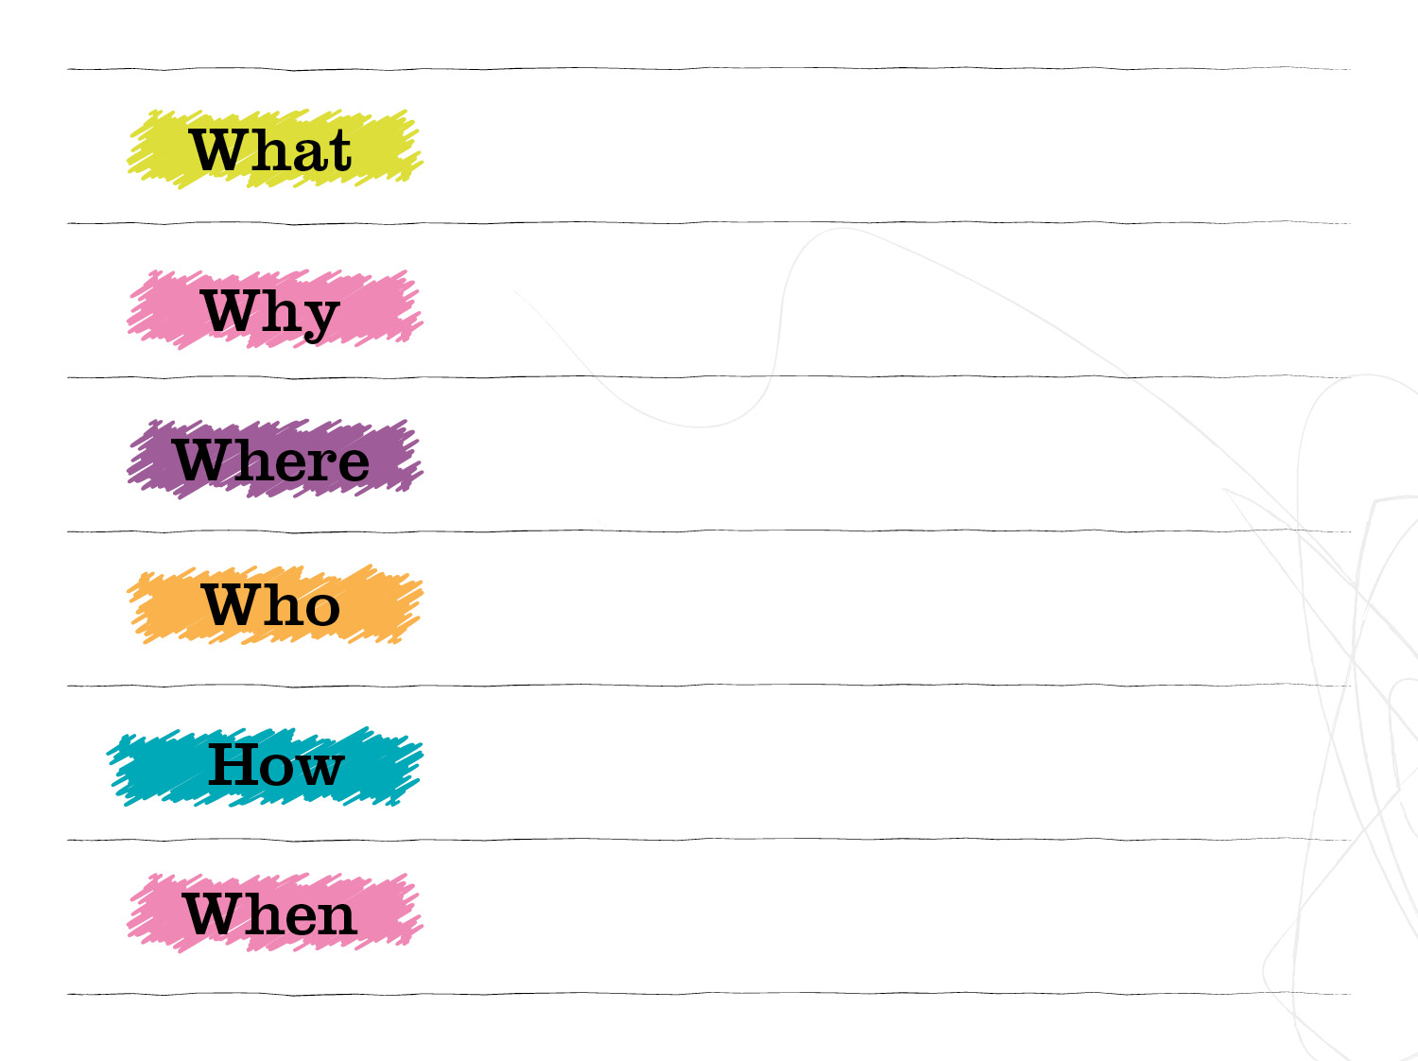
Outdoor staff space
Decrease stress
School grounds /
Community space
Art school / Local architects /
Mens shed
Stalled spaces funding /
RHS project
6 months to plan and
identify funding

Slide 38
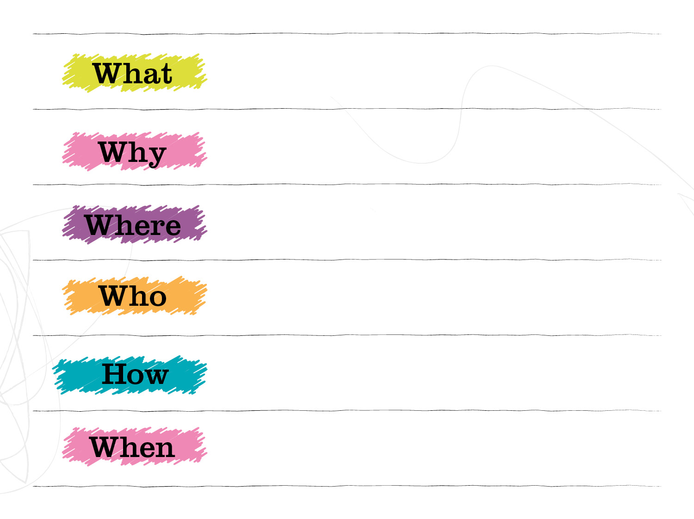
Walking meetings
Creative thinking / Social distancing / Community visibility
Within 30mins of School
Geography / Modern studies department / Student project / Local Historical society / Art and Design
Identify Routes / Create route maps / Design leaflets / Write guidance for staff meetings
Summer / Autumn

Slide 39

Next steps…

